Slide 1
Transcriptome Analysis Using RNA-Seq
Emily Isko

Slide 2
Microarrays vs. RNASeq
Coverage limited by microarray design
High background - Noisy
Limited dynamic range
Comparison across different experiments difficult
Results do not depend on prior knowledge of transcriptome
Less noise
Bigger dynamic range
Less RNA needed
Single base resolution
High levels of technical and biological reproducibility
Wang, Z., Gerstein, M., Snyder, M., 2009. RNA-Seq: a revolutionary tool for transcriptomics. Nature Reviews Genetics 10, 57–63. https://doi.org/10.1038/nrg2484
Notes:
Microarrays:
- Dynamic range limited: get saturation
RnaSeq
Single base resolution: Provide location of transcription boundaries, exon connectivity, sequence variations
Bigger dynamic range: no upper limit for quantification
Highly accurate when compared with qPCR and spike-in controls

Slide 3
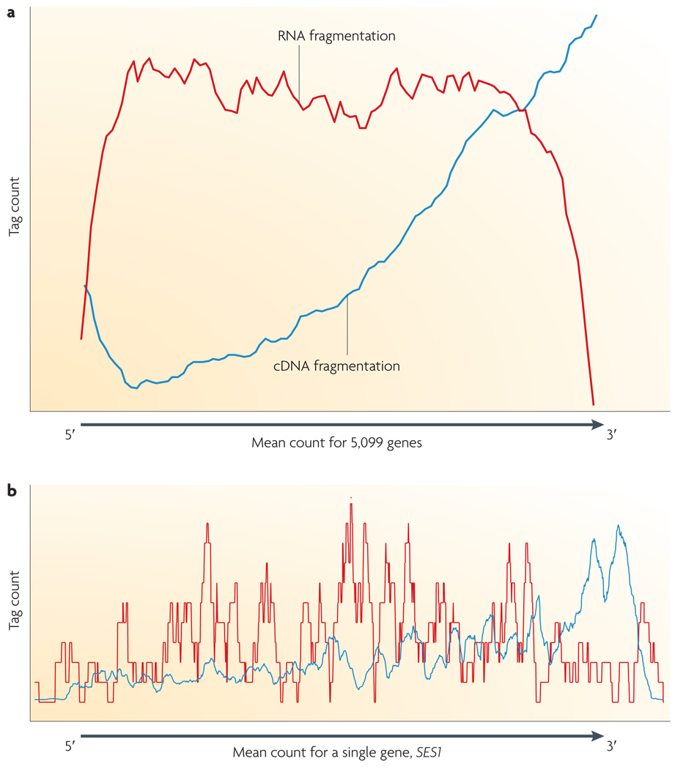
Drawbacks and Challenges of RNA-seq
Coverage of beginning/ends of reads/transcripts not as good
Due to fragmentation
PCR bias
Repetitive regions - computation
Wang, Z., Gerstein, M., Snyder, M., 2009. RNA-Seq: a revolutionary tool for transcriptomics. Nature Reviews Genetics 10, 57–63. https://doi.org/10.1038/nrg2484

Slide 4
Samples
Extraction
RNA-Seq
Genomic Material (RNA)
Library prep
(fragmentation, labeling)
RNA/cDNA library
NGS sequencing (Illumina)
Raw Reads
Computational processing and analysis
Data

Slide 5
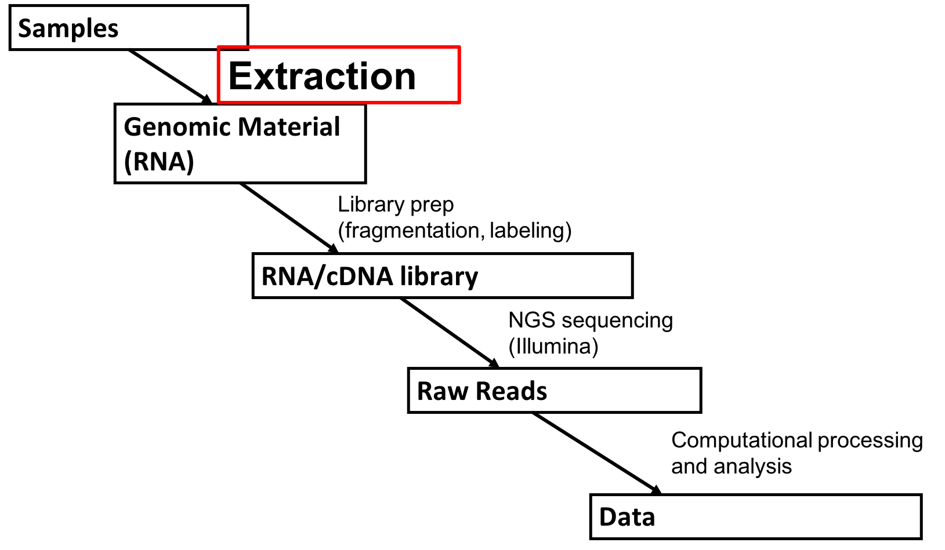
RNA Extraction

Slide 6
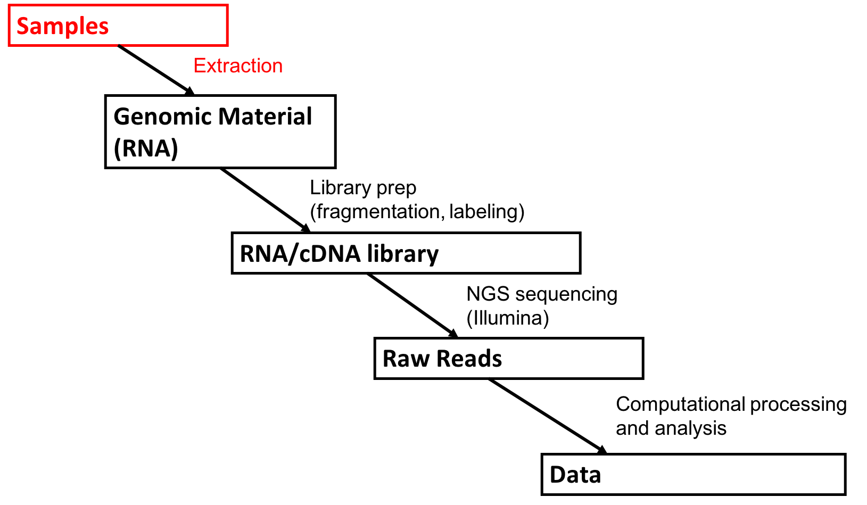
RNA extraction
Can be optimized for different sized RNA
E.g. mRNA vs. microRNA
DNA digestion step

Slide 7
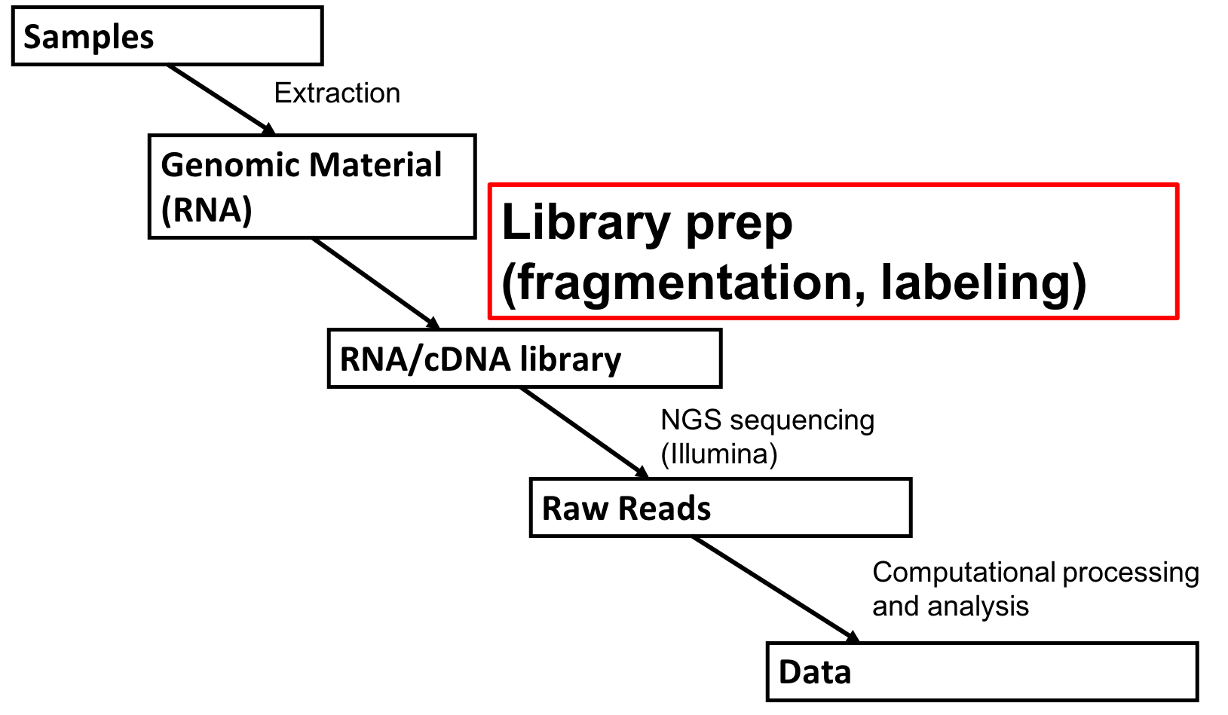
Library Prep

Slide 8
Library Prep
Ribosomal depletion
(mRNA enriching – optional)
Fragmentation
Amplification (random hexamers)
Adapter ligation
Pic of method
Notes:
https://www.labome.com/method/RNA-seq-Using-Next-Generation-Sequencing.html

Slide 9
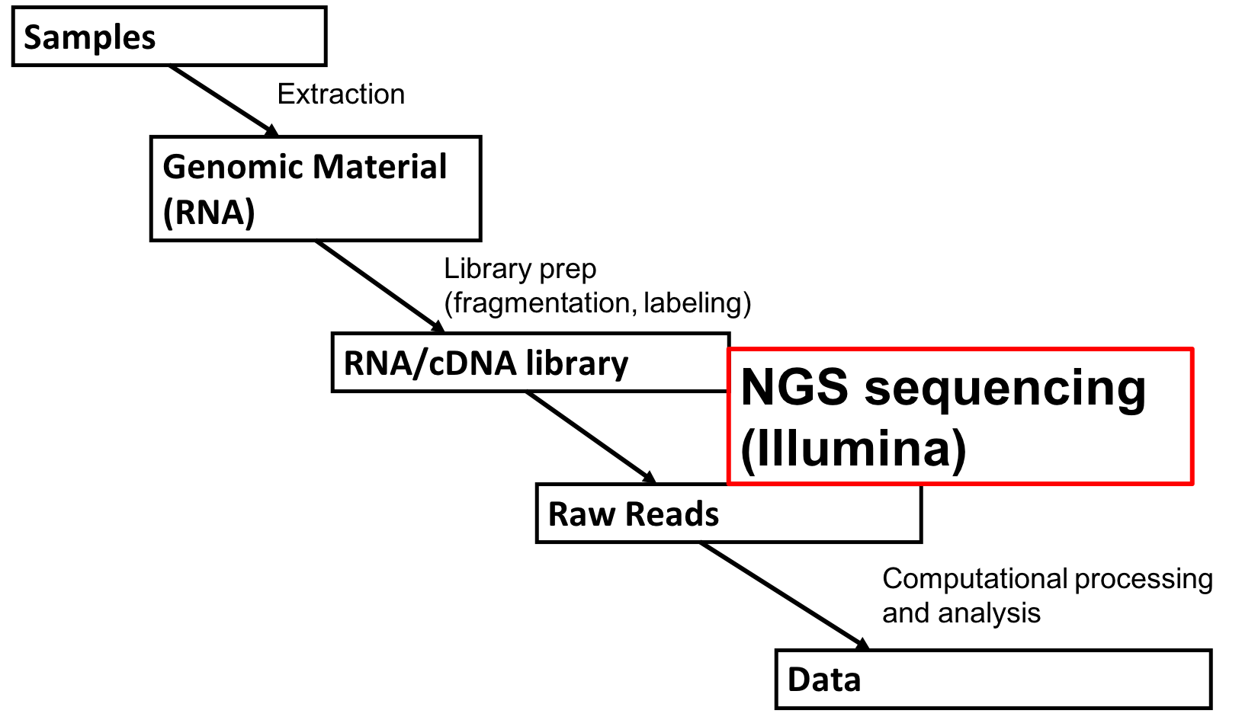
NGS Sequencing

Slide 10
NGS Sequencing
Illumina
Bridge amplification – PCR bias
Flourescence – Sequencing by synthesis (SBS)
https://www.youtube.com/watch?v=fCd6B5HRaZ8
Different coverage (20x vs. 50x vs. 100x)

Slide 11
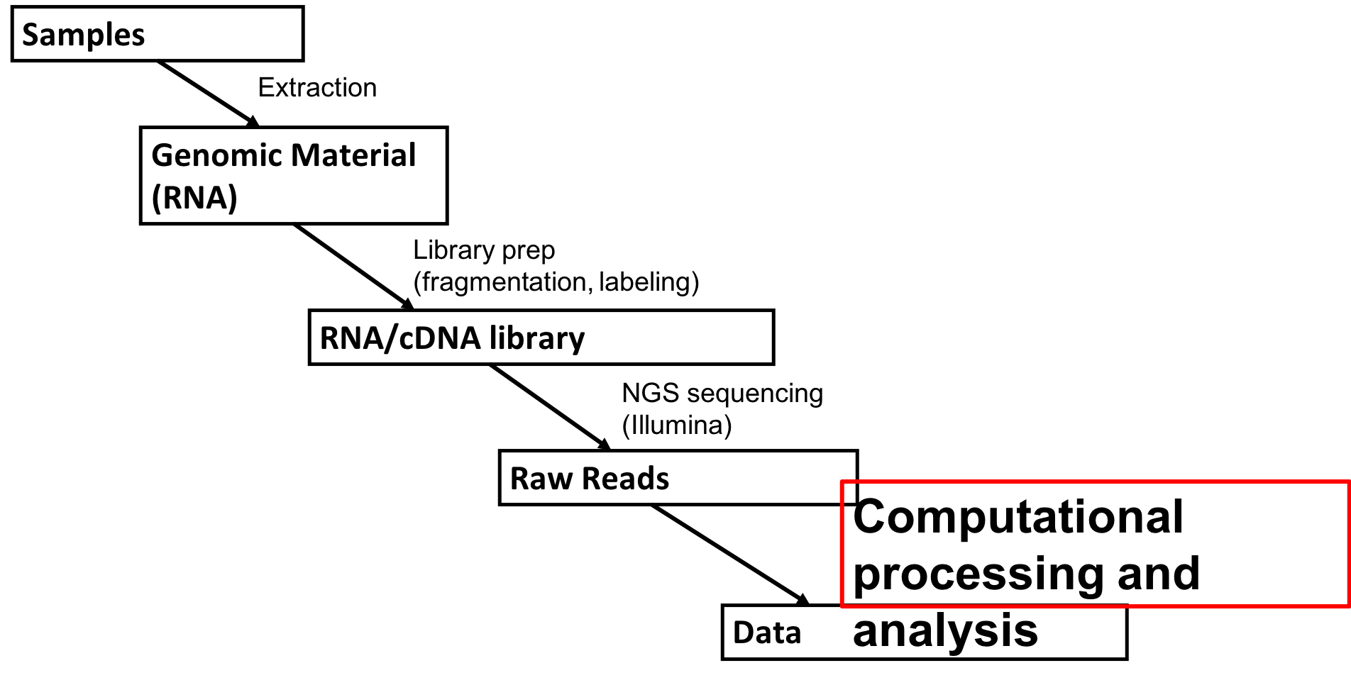
Computational Processing

Slide 12
Computational Processing: RNA-seq Pipeline
BIOWULF
R Studio
Figure modified from Griffith lab online Rna Seq tutorial
Notes:
https://www.nature.com/articles/nprot.2016.095

Slide 13
Samples
Extraction
RNA-Seq
Genomic Material (RNA)
Library prep
(fragmentation, labeling)
RNA/cDNA library
NGS sequencing (Illumina)
Raw Reads
Computational processing and analysis
Data

Slide 14
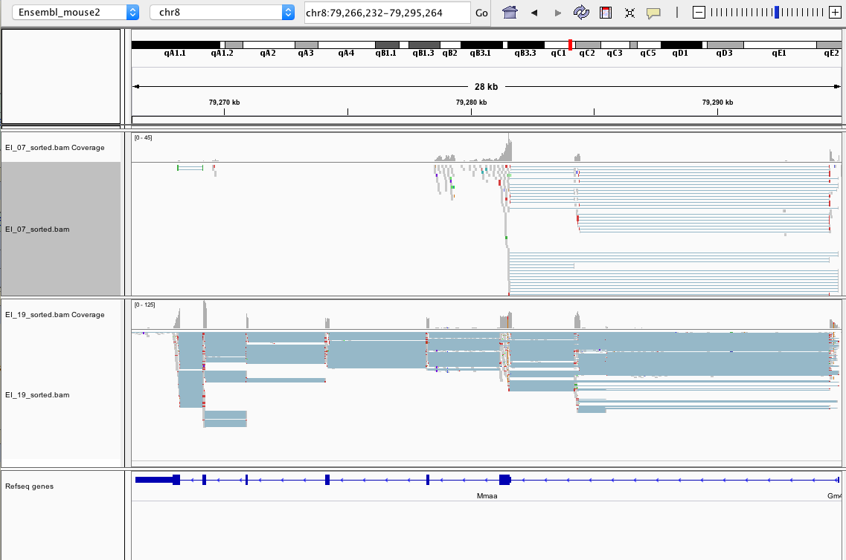
Mmaa Rna
IGV Browser
Affected (-/-)
Exons 3-5 deletion
Unaffected (+/-)
7
6
5
4
3
2
1b
1a
Mmaa

Slide 15
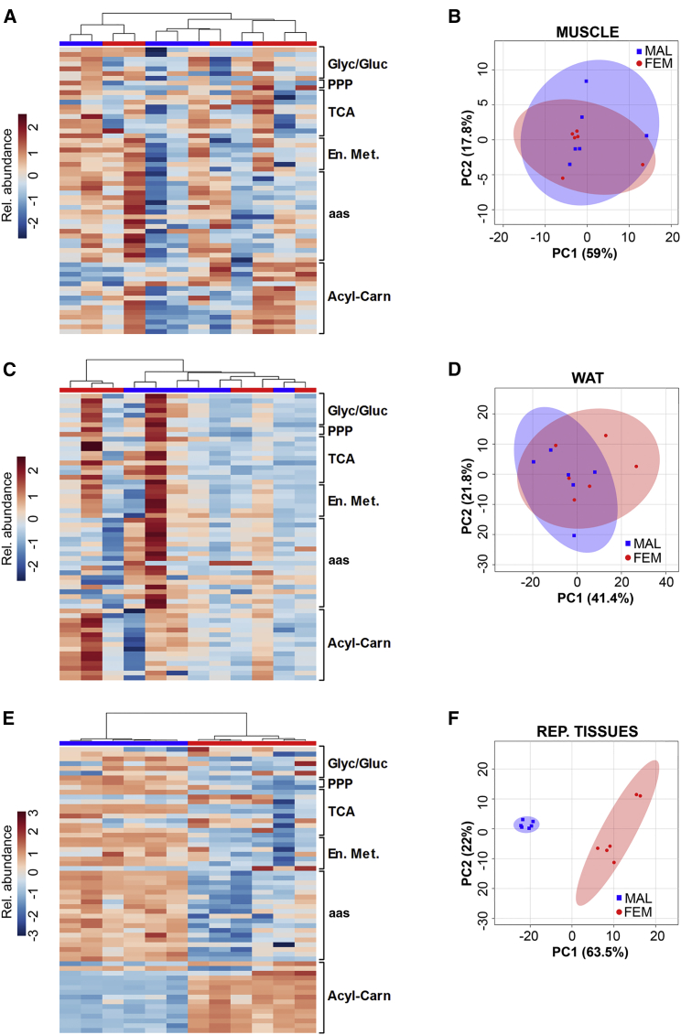
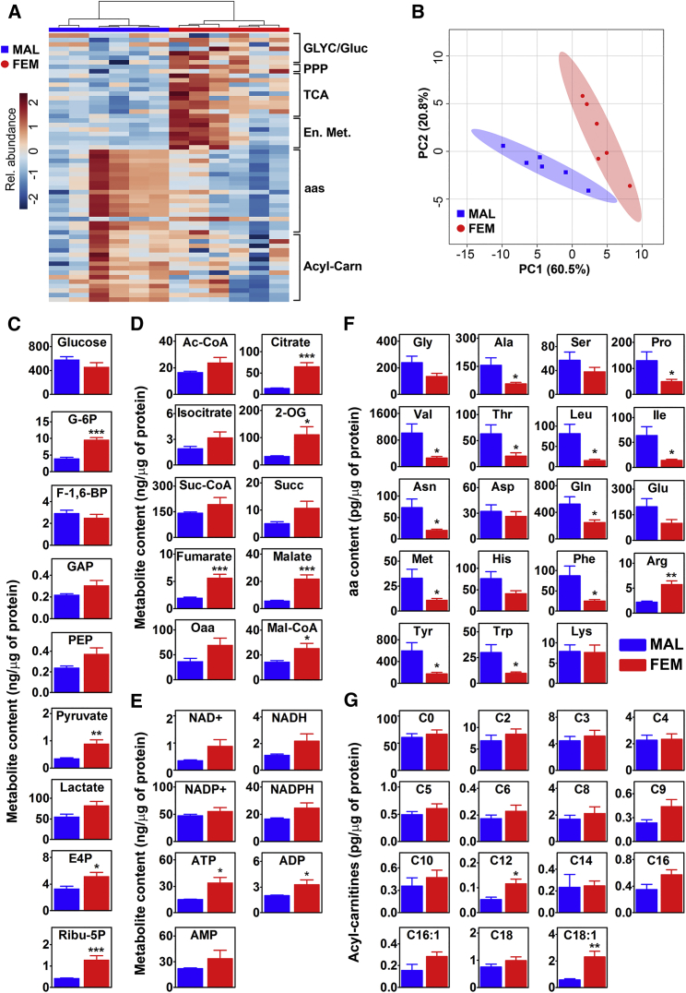
PCA – Principle Component Analysis
Accounts for greatest variation among data set
Used to identify sample clustering
Example of PCA from Della Torre et al., 2018:
Metabolites not RNA
Liver
Notes:
Sample clustering: i.e. samples that are more similar to each other based on all observations

Slide 16
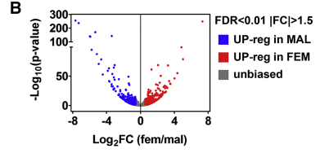
Volcano Plots
Visualize distribution/number of significant DEGs
DEG = differentially expressed gene
False Discovery Rate (FDR) or q value
More stringent p value for multi-sampling
Sample Volcano Plot form Della Torre et al., 2018

Slide 17
Gene Selection Strategy for qPCR Validation
Significantly different in affecteds compared to unaffecteds without treatment using FDR <0.05
Improves with vancomycin in affecteds
High expression in liver, depending on the functional assignment
Transcriptional regulators vs enzymes
Observed dysregulation in MUT patients and mice
Microarray: Manoli et al., 2013
Proteomics – Randy, Jen, Chuck: Caterino et al., 2016
Affected
Affected
Vancomycin
Vancomycin
Log₂(Fold change)
Notes:
Pigr – pathway to secrete secreted IgA, receptor sit on basal surface of trachea, intestine
Larger complex, protect from bacterial/virus, barrier to microbes

Slide 18
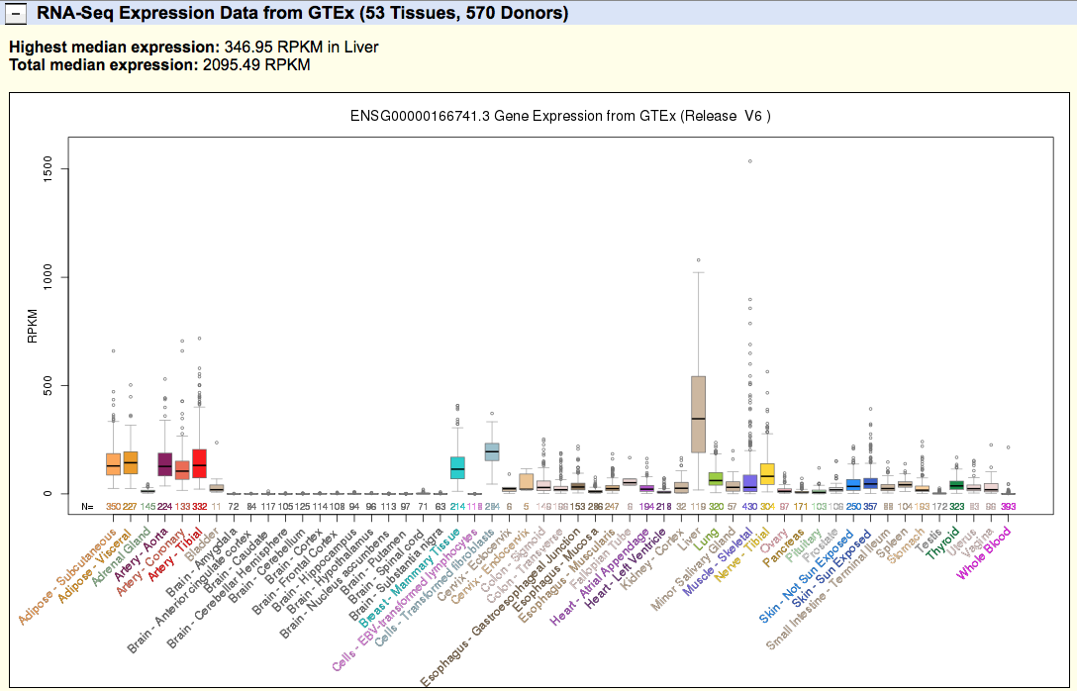
2. High Expression in Liver
UCSC genome browser
Tissue specific expression of human Nnmt

Slide 19
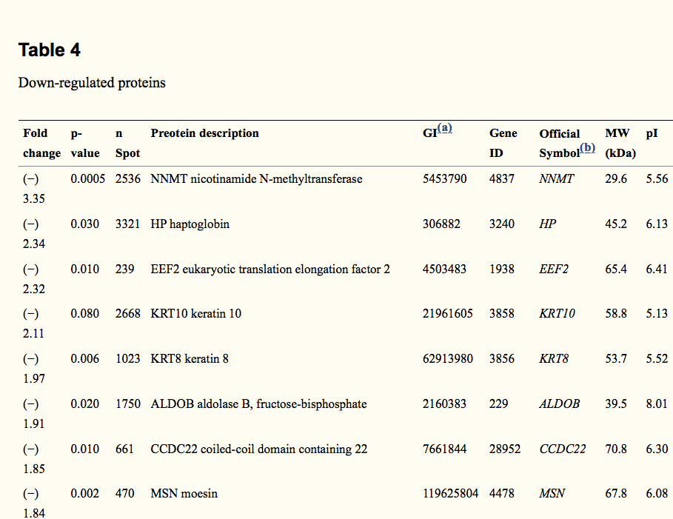
3. Observed dysregulation in MUT
Microarray
proteomics
Table 4 from
Caterino et al., 2016

Slide 20
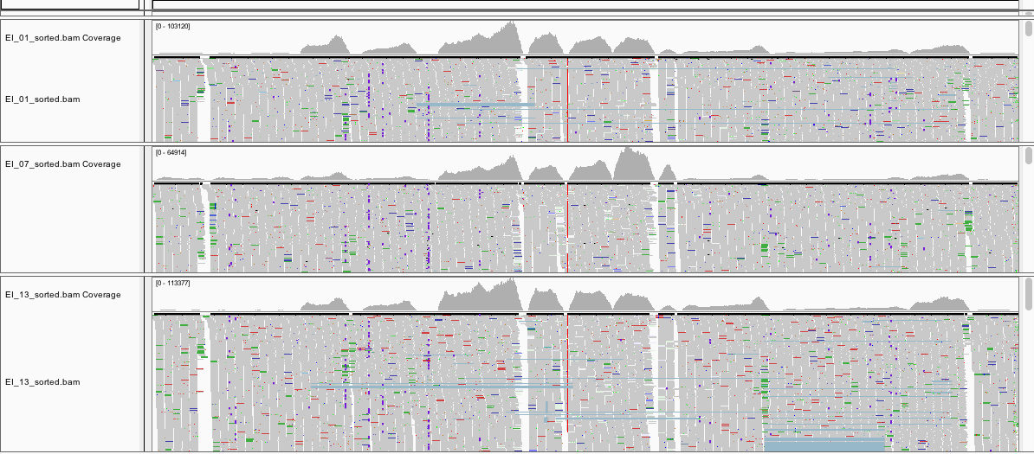
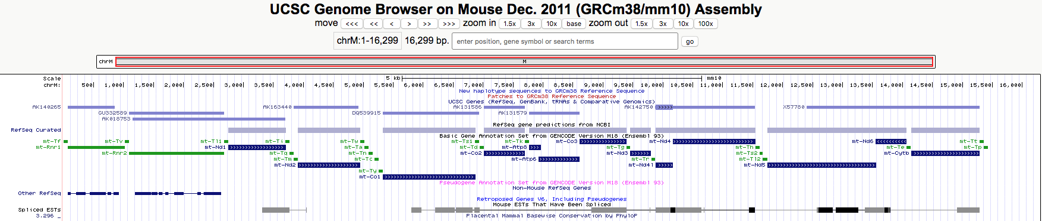
Many reads mapped to mitochondrial DNA
Derek’s input:

Slide 21
Resources
Review(s) of RNA-seq:
General overview – (Wang et al., 2009) https://www.ncbi.nlm.nih.gov/pubmed/19015660]
In-depth review – (Corney, 2013; updated 2018) https://www.labome.com/method/RNA-seq-Using-Next-Generation-Sequencing.html
Computational Resources:
Unix/shell tutorial: https://www.datacamp.com/courses/introduction-to-shell-for-data-science
For local laptop – conda/bioconda essentials: https://conda.io/projects/conda/en/latest/user-guide/getting-started.html
For cloud computing - Biwulf Online Class: https://hpc.nih.gov/training/intro_biowulf/
Overview of RNA-seq pipeline: (Persea et al., 2016) https://www.nature.com/articles/nprot.2016.095
General RNA-seq pipeline: (Dave Tang’s Blog) https://davetang.org/muse/2017/10/25/getting-started-hisat-stringtie-ballgown/
In-depth RNA-seq pipeline tutorial: (Griffith Lab) https://github.com/griffithlab/rnaseq_tutorial

Slide 22
End

Slide 23
Other applications of RnaSeq
Variant calling (SNPs/SNVs)
Isoform analysis (quantification and discovery)
Allele specific expression
Single cell sequencing

Slide 24
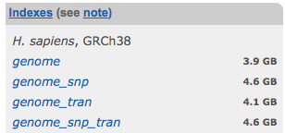
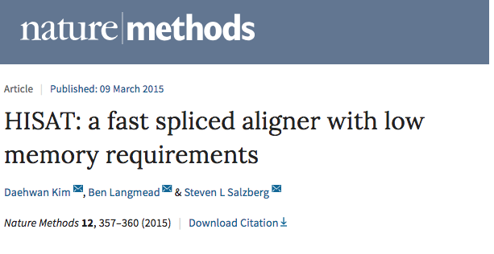
Alignment with HISAT
Requires Hisat index from reference genome
Reference genome (.fa) influence alignment
Much memory to make index
Can download from website
Hisat
Raw Reads (.fastq or .fq.qz)
Aligned Reads (.sam)

Slide 25
Transcriptome Assembly with Stringtie
Gene annotation files (GTF/GFF)
Source must match reference sequence used
Assigns reads to exon/introns/transcripts and counts
Gene annotation fiel (gtf/gff)
Stringtie
Gene abundances.tsv
Aligned Reads (.bam)

Slide 26
Expression analysis with Ballgown and R
Easily pull out exon/intron/transcript data to put in table
Builtin functions designed to analyze rnaseq data
Ballgown & R
Gene abundances.tsv
DEGs
Visualization

Slide 27
Fastq files
.fastq or .fq.gz
Notes:
Image: https://www.researchgate.net/figure/FASTQ-file-1st-line-always-starts-with-the-symbol-followed-by-the-sequence_fig7_256095540

Slide 28
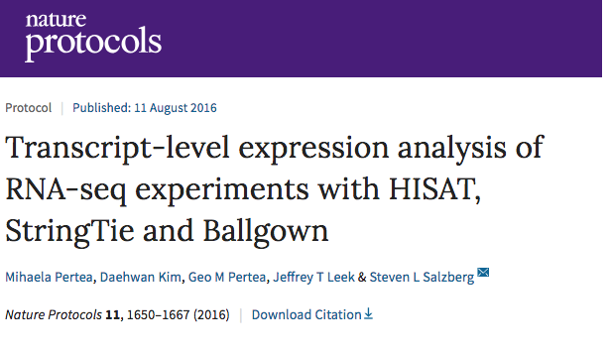

Slide 29
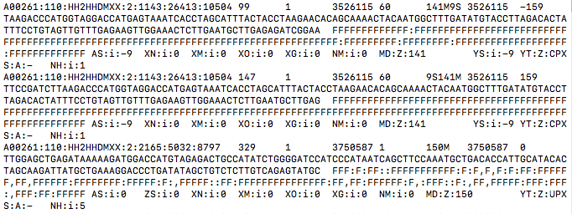
Sequence Alignment/Map format
Can be as large as 25g --> .bam format using samtools
Samtools
Aligned Reads (.sam)
Condensed Aligned Reads (.bam)
Notes:
See https://samtools.github.io/hts-specs/SAMv1.pdf

Slide 30
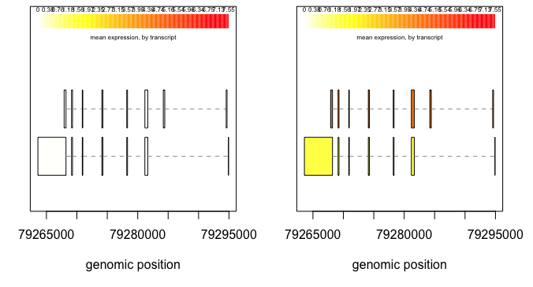
Mmaa expression in sham treated Affecteds vs. Unaffecteds
Affecteds (-/-)
Unaffecteds (+/-)
Direction of Transcription
Notes:
Scale? Compare to overall expression levels? Mean expression levels?

